Slide 1
Software Reliability and Quality Control
Gu Qing
Nanjing University
2020年4月12日

Slide 2
Chapter 8. Applying Failure Data
Reliability Growth Test
Certification Test
Special Situations

Slide 3
3. Special Situations
Evolving programs
Unreported failures
Operational profile variation

Slide 4
Evolving Programs
Reliability growth model
In estimating FI (λ), tested software is assumed to be stable
No changes other than failure correction
But software is evolving
Requirements changes
Integration of new features
Adapt to changing hardware and software environment
Enhancement due to technological progress
Necessity for system performance improvement
Evolution as part of the development process

Slide 5
Handle Evolution
Handle slowly and small changes by the same model
Ignore changes for <5% size increments per week
Weighting recent failure data more heavily
Ignore old failure data in old phases, re-estimate based on new data
Stepwise evolution
Component by component
Operation group by operation group
Notes:
By computing λ, larger group in elder phase
Stepwise是另一种情况

Slide 6
Stepwise Evolution
Stepwise developing / testing
The software is tested in an evolutionary fashion, one component or operation group is turned on, then another
The failures are recorded in an evolutionary fashion, observed per component or operation group
Problems
Extra data collection required because of multiple elements
Greater estimation error due to smaller sample sizes

Slide 7
Component by Component
Consideration
Each component must be substantial and independent (by development group)
Have enough failure data to make useful estimations
May use similar models with different parameters
Methods
Estimate λ for each component
Add the component λs to obtain the system λ
Example
A system has component A and B
A has λ_{A} 15 failures per 1kh, B has λ_{B} 20 failures per 1kh
λ of the system will be 35 failures per 1kh
Notes:
不同的开发团队

Slide 8
Operation Group by Operation Group
Consideration
Each operation group must be substantial and independent (by test group)
Have enough failure data to make useful estimations
May use similar models with different parameters
Methods
Estimate λ for each operation group
Sum λs of each operation group weighted by total occurrence probabilities
Example
A system has operation group A and B
A has total probability 0.6, λ_{A} 5 failures per 1kh; B has total probability 0.4, λ_{B} 10 failures per 1kh
λ of the system will be: 0.6×5+0.4×10 = 7 failures per 1kh
Notes:
不同的系统测试团队

Slide 9
Unreported Failures
Situations where failures not reported (recorded)
Less severe failures not halting software execution
Failures misidentified
More failures missed in load test than in feature or regression test
Exact input and output states may be unknown
Note: even more unnoted by users
Unreported failures mean the underestimating of actual λ

Slide 10
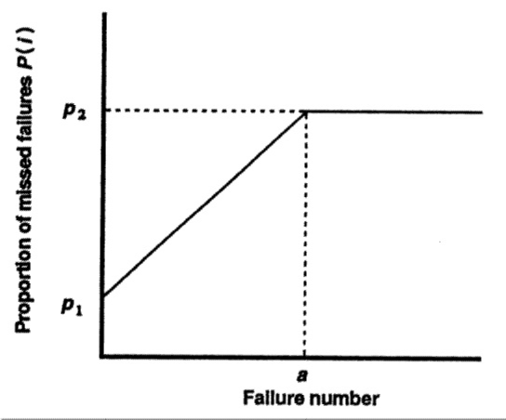
Modeling Unreported Failures
A simple linear model
P(i) – probability that i^{th} failure gets unnoticed
p₁ – probability of not observing particular failure at start of test
p₂ – constant probability of not observing failure as test makes habitude

Slide 11
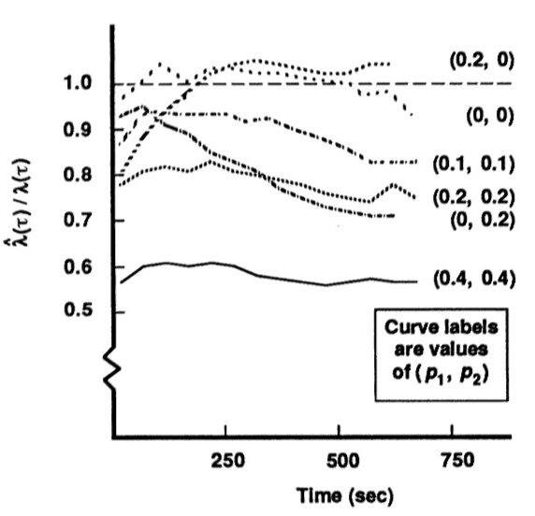
Basic Exponential Model (1)
Expected λ at execution time τ
Simulation
Let ν₀ = 250 failures, λ₀ = 1.25 failures per second
Generate 1000 different failure time sequences based on BE
Each failure i missed according to P(i)
Plot the ratio of observed λ to ideal one

Slide 12
Basic Exponential Model (2)
If P(i) increases with time
The estimate for FI is low and becomes lower as time passes
If P(i) decreases with time
The estimate for FI is initially low and becomes better as time passes
If P(i) is constant (p₁ = p₂)
Estimates for FI ratio fluctuates around 1–p₂
i.e. simple correction by dividing (1–p₂)

Slide 13
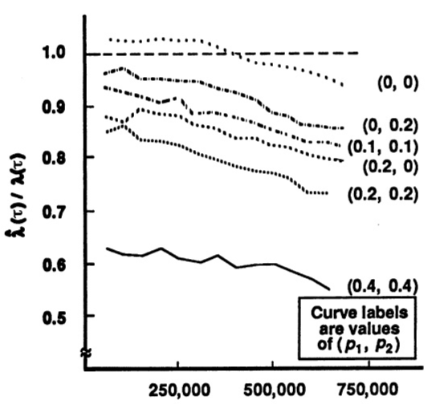
Logarithmic Poisson Model
Expected λ at execution time τ
Simulation
Let λ₀ = 1.25 failures per second, θ = 0.05 per failure
Generate 1000 failure time sequences for LP, same as previous
Result
Can adjust by dividing (1–p₂), but not so good as BE

Slide 14
Operational Profile Variation (1)
Problem
If encounter a number of different operational profiles in field use
How to transform current λ_{S} to confident λ_{D} for new profiles without further testing
Consideration
Estimate λ_{k} for each operation
Operations are independent, initial λ₀ is similar, probability of failure occurrence is similar
Notes:
All new operations

Slide 15
Operational Profile Variation (2)
Transform expression
n – total number of operations
p_{S}^{k} or p_{D}^{k} – occurrence probability of operation k in old / new operational profile
λ_{k} – estimated λ for operation k
Notes:
What if new + reused

Slide 16
Operational Profile Variation (3)
Estimate of λ_{k} depends on models used
BE model
LP model
τ_{F} – the execution time of test
~
~
Notes:
单个操作的参数：系统假想为Q个同一操作
BE－λ₀，λ₀/ν₀
LP－λ₀，θ

Slide 17
思考题
考虑失效记录缺失
基于BE模型：λ₀=10, v₀=200
基于LP模型：θ=0.03, λ₀=15
生成随机失效记录
基于u(t), 以5个失效为一组，计算t(u=5), t(u=10), ...
采用随机数法计算0~t(5), t(5)~t(10), ...单个失效发生时间
令a=50，分别基于(p1,p2) = (0, 0.2), (0.2, 0), (0.2, 0.2)改为缺失的失效记录
采用组队计算(k=3)法计算

Slide 18
Summary
Reliability Growth Test
FI/FIO ratio: concepts, estimation, judgments
Certification Test
Reliability demonstration chart: regions and parameters, judgments
Special Situations
Evolving programs, Unreported failures, Operational profile variation

